Slide 1
UMET9G-30-1 Accounting & Finance for Decision Making Investment Appraisal – part 2, NPV and IRR

Slide 2

Recap
Last week we covered:
Understanding Capital Budgeting Decision Making
Identify four key investments appraisal techniques used in industry
Consider Payback period and ARR and how they are used and calculated
Review the advantages and disadvantages of the techniques
Notes:
NOTE TO STUDENTS: Please see last weeks lecture slides and make sure you review them so that you understand how

Slide 3
Learning Outcomes
Consider why the time value of cash flows is important within an investment decision.
Apply the NPV and IRR calculations to a given scenario
Review the advantages and disadvantages of both methods.
Consider the Net Present Value (NPV) and Internal Rate of Return (IRR) method and how they are calculated

Slide 4
Recap: Why….
Capital
Assets = Equity + Liabilities
Return
Shareholders (owners!) invest funds for a reason… a return! Return is generated by management investing in real assets, so managers need to analyse different investment opportunities.

Slide 5
Key characteristics
Method: Calculated using:
Accounting Rate of Return Profits
Payback Period Cash Flows
Net Present Value Cash Flows
Internal Rate of Return Cash Flows
Remember one of the key disadvantages of ARR & Payback is that they do not consider the timing of profits or cash flows.

Slide 6
Recap: Time Value of Money
You are offered £1,000 now or £1,000 in one year’s time. What would you choose? £1,000 now. Why?
Risk
Inflation
Investment Opportunities
Cost of Capital, e.g. pay off a loan
So money has a time value!
If interest rates are 10% per year, the future value of £1,000 will be £1,100 in year one and £1,210 in year 2. Alternatively we can say that £1,100 in one year has a present value of £1,000.
The further into the future we go, the lower the net present value, i.e. £1,000 now is worth more than £1,000 in 5 years time.
NPV takes into account the Time Value of Money!

Slide 7
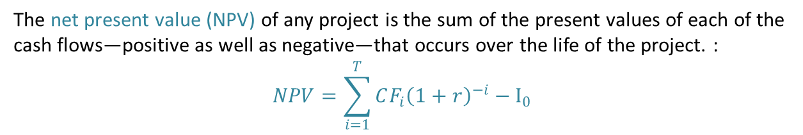
Net Present Value
The net present value (NPV) of any project is the sum of the present values of each of the cash flows—positive as well as negative—that occurs over the life of the project. :
$$NPV=\sum_{i=1}^{T}{CF_{i}{\left(1+r\right)}^{−i}}−I_{0}$$
Example 1 – Investment Decision
Shoez Co. plans to launch a new shoe line and must choose between two designs. These projects are mutually exclusive. Using a discount rate of 7%, which design should Shoez Co. choose?
Design 1: has an initial cost of $100,000 and a salvage value of $25,000 after four years.
Design 2: has an initial cost of $100,000 and a salvage value of $50,000 after four years.
Year | 1 | 2 | 3 | 4
Design 1 ($/year) | 25,000 | 29,000 | 32,000 | 35,000
Design 2 ($/year) | 15,000 | 20,000 | 25,000 | 18,000

Slide 8


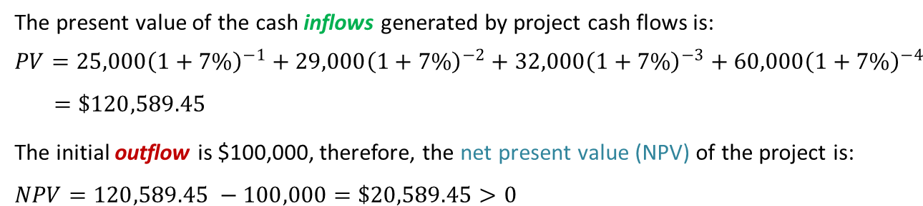









Capital Budgeting – NPV
Design 1: has an initial cost of $100,000 and will have a scrap value of $25,000 after four years.
$$\$25,000$$
$$−\$100,000$$
$$\$25,000$$
$$\$29,000$$
$$\$32,000$$
$$+$$
$$\$35,000$$
$$t=0$$
$$t=1$$
$$t=2$$
$$t=3$$
$$t=4$$
The present value of the cash inflows generated by project cash flows is:
$$PV=25,000{\left(1+7\%\right)}^{−1}+29,000{\left(1+7\%\right)}^{−2}+32,000{\left(1+7\%\right)}^{−3}+60,000{\left(1+7\%\right)}^{−4}$$
$$=\$120,589.45$$
The initial outflow is $100,000, therefore, the net present value (NPV) of the project is:
$$NPV=120,589.45 −100,000=\$20,589.45>0$$

Slide 9
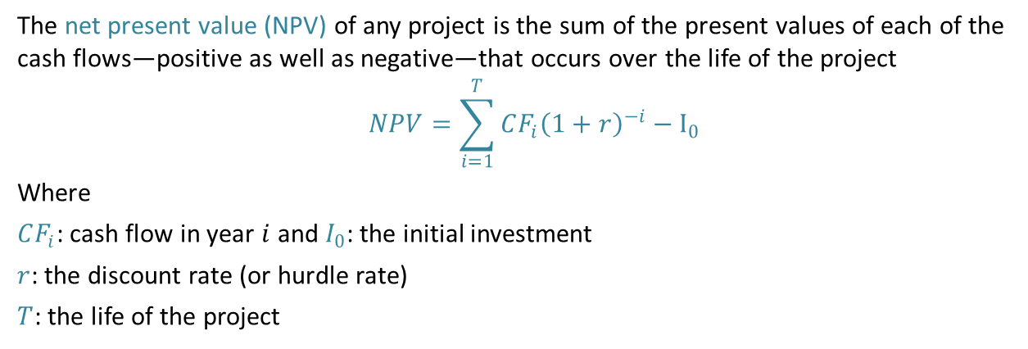
Capital Budgeting – Net Present Value
The net present value (NPV) of any project is the sum of the present values of each of the cash flows—positive as well as negative—that occurs over the life of the project
$$NPV=\sum_{i=1}^{T}{CF_{i}{\left(1+r\right)}^{−i}}−I_{0}$$
Where
$CF_{i}$: cash flow in year $i$ and $I_{0}$: the initial investment
$r$: the discount rate (or hurdle rate)
$T$: the life of the project
Measurement unit
The NPV is always expressed in monetary units.
Decision Rule
(i) Independent project: Accept a project if NPV > 0.
(ii) Mutually exclusive: Accept project with highest NPV as long as NPV > 0.
Notes:
Where can we get discount rates from?
Choice based on: current interest rate, weighted average cost of capital (WACC) or a market rate/company target.
It is not unusual for more than one decision rules needing to be satisfied, e.g. a payback period of less than 2 years and a 10% rate of return.

Slide 10
Capital Budgeting – NPV
Design 2: has an initial cost of $100,000 and a salvage value of $50,000 after four years. The generated cash flows from both projects are:
Using a discount rate of 7%, what is the NPV of Design 2?
Would the company accept this project?
Which project should the company choose?
Year | 1 | 2 | 3 | 4
Design 2 ($/year) | 15,000 | 20,000 | 25,000 | 18,000

Slide 11
Net Present Value – the discount factor
The discount factor can also be referred to as the following:
the cost of capital
the annual rate of return
the present value factor
BUT REMEMBER!!!
The discount factor for year 0 (NOW) is always 1.00

Slide 12
Net Present Value
Project A |  |  |  |  |  |  | Project B
 | Cash Flow |  | Disc. Factor |  | Disc. CF |  |  | Cash Flow |  | Disc. Factor |  | Disc. CF
 |  |  | 10% |  |  |  |  |  |  | 10%
0 | (100,000) | x | 1 | = | (100,000) |  | 0 | (20,000) | x | 1 | = | (20,000)
1 | 50,000 | x | 0.909 | = | 45,450 |  | 1 | 10,000 | x | 0.909 | = | 9,090
2 | 50,000 | x | 0.826 | = | 41,300 |  | 2 | 20,000 | x | 0.826 | = | 16,520
3 | 50,000 | x | 0.751 | = | 37,550 |  | 3 | 20,000 | x | 0.751 | = | 15,020
 |  |  | NPV | = | 24,300 |  |  |  |  | NPV | = | 20,630
Which one should we choose?
Project A provides a higher NPV.
But Project B requires much less capital investment.

Slide 13


Capital Budgeting – NPV
The NPV is a preferred decision-making criterion because it:
all cash flows used.
timing of cash flows taken into account.
calculations easy to make with tables.
directly shows change to shareholders’ wealth as a result of the decision.
allows variable discount rates to account for different economic circumstances.
can be aggregated across all projects.
However, it:
is stated in absolute value and does not provide a percentage return on the initial investment.
does not control for the life of the project and is biased towards projects with longer lives.
is based on forecasted cash flows which could lead to errors.
required rate of return difficult to ascertain.
not easily understood by non-finance staff.

Slide 14
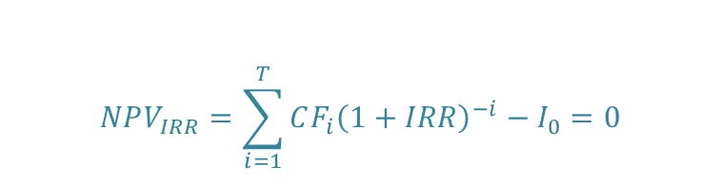
Internal Rate of Return (IRR)
The Internal Rate of Return (IRR) takes into account the project’s scale, therefore, offsetting the NPV bias toward long-term projects. It calculates the percentage at which the investment proposal breaks-even, recognising that money has a time value.
The IRR is a percentage term, therefore, it can be used to compare different projects.
The IRR = the discount rate that makes the NPV of a project equal to zero.
$$NPV_{IRR}=\sum_{i=1}^{T}{CF_{i}{\left(1+IRR\right)}^{−i}}−I_{0}=0$$
The investment decision:
Proceed with the project if its IRR is higher than the company’s requirement return.

Slide 15
IRR is an NPV of zero??
Year
0
1
2
3
Cash Flow
(100,000)
50,000
50,000
50,000
x
x
x
x
Disc. Factor
(10%)
1.000
0.909
0.826
0.751
Disc. Cash Flow
(100,000)
45,450
41,300
37,550
NPV = 24,300
=
=
=
=
In this example we can see that the project will generate positive NPV when a 10% discount factor is applied, £24,300. Because the NPV is positive this means that this project is generating a return greater than 10%.
If the calculation had produced a negative NPV then we would reject the project because the project is generating a return less than 10%.
Therefore, if the project generated an NPV of exactly £0 (zero) then we can say that this project generates a return which is equal to the discount factor applied, in other words 10%. This is the IRR.

Slide 16
IRR - example
Therefore, the IRR lies between 20% and 22%, closer to 22%

Slide 17
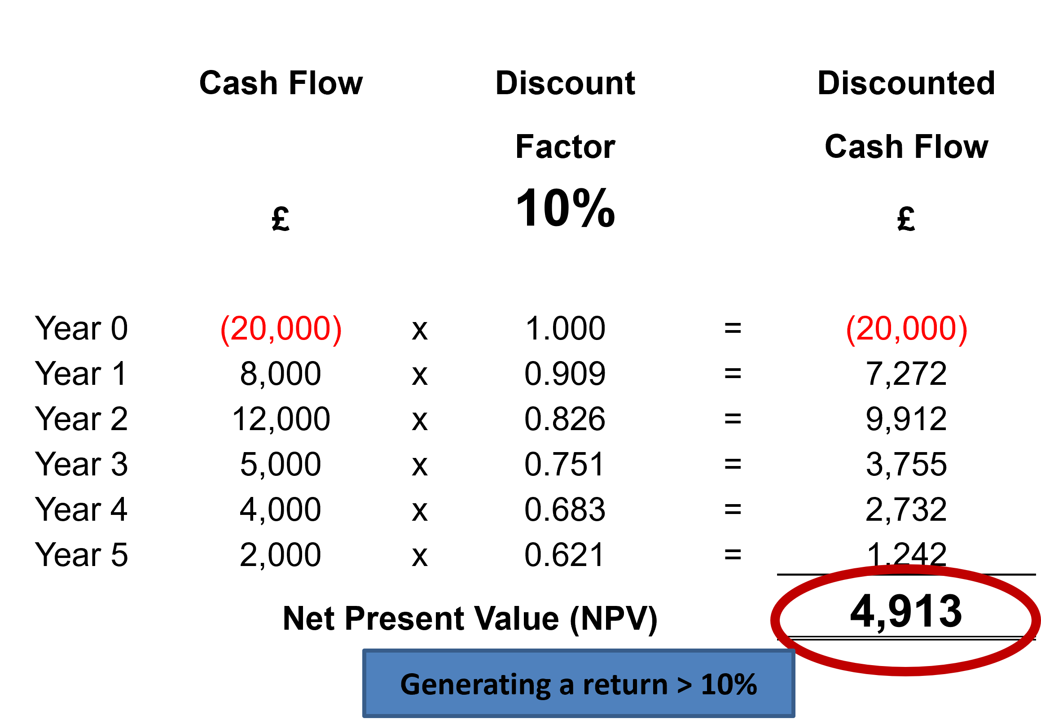
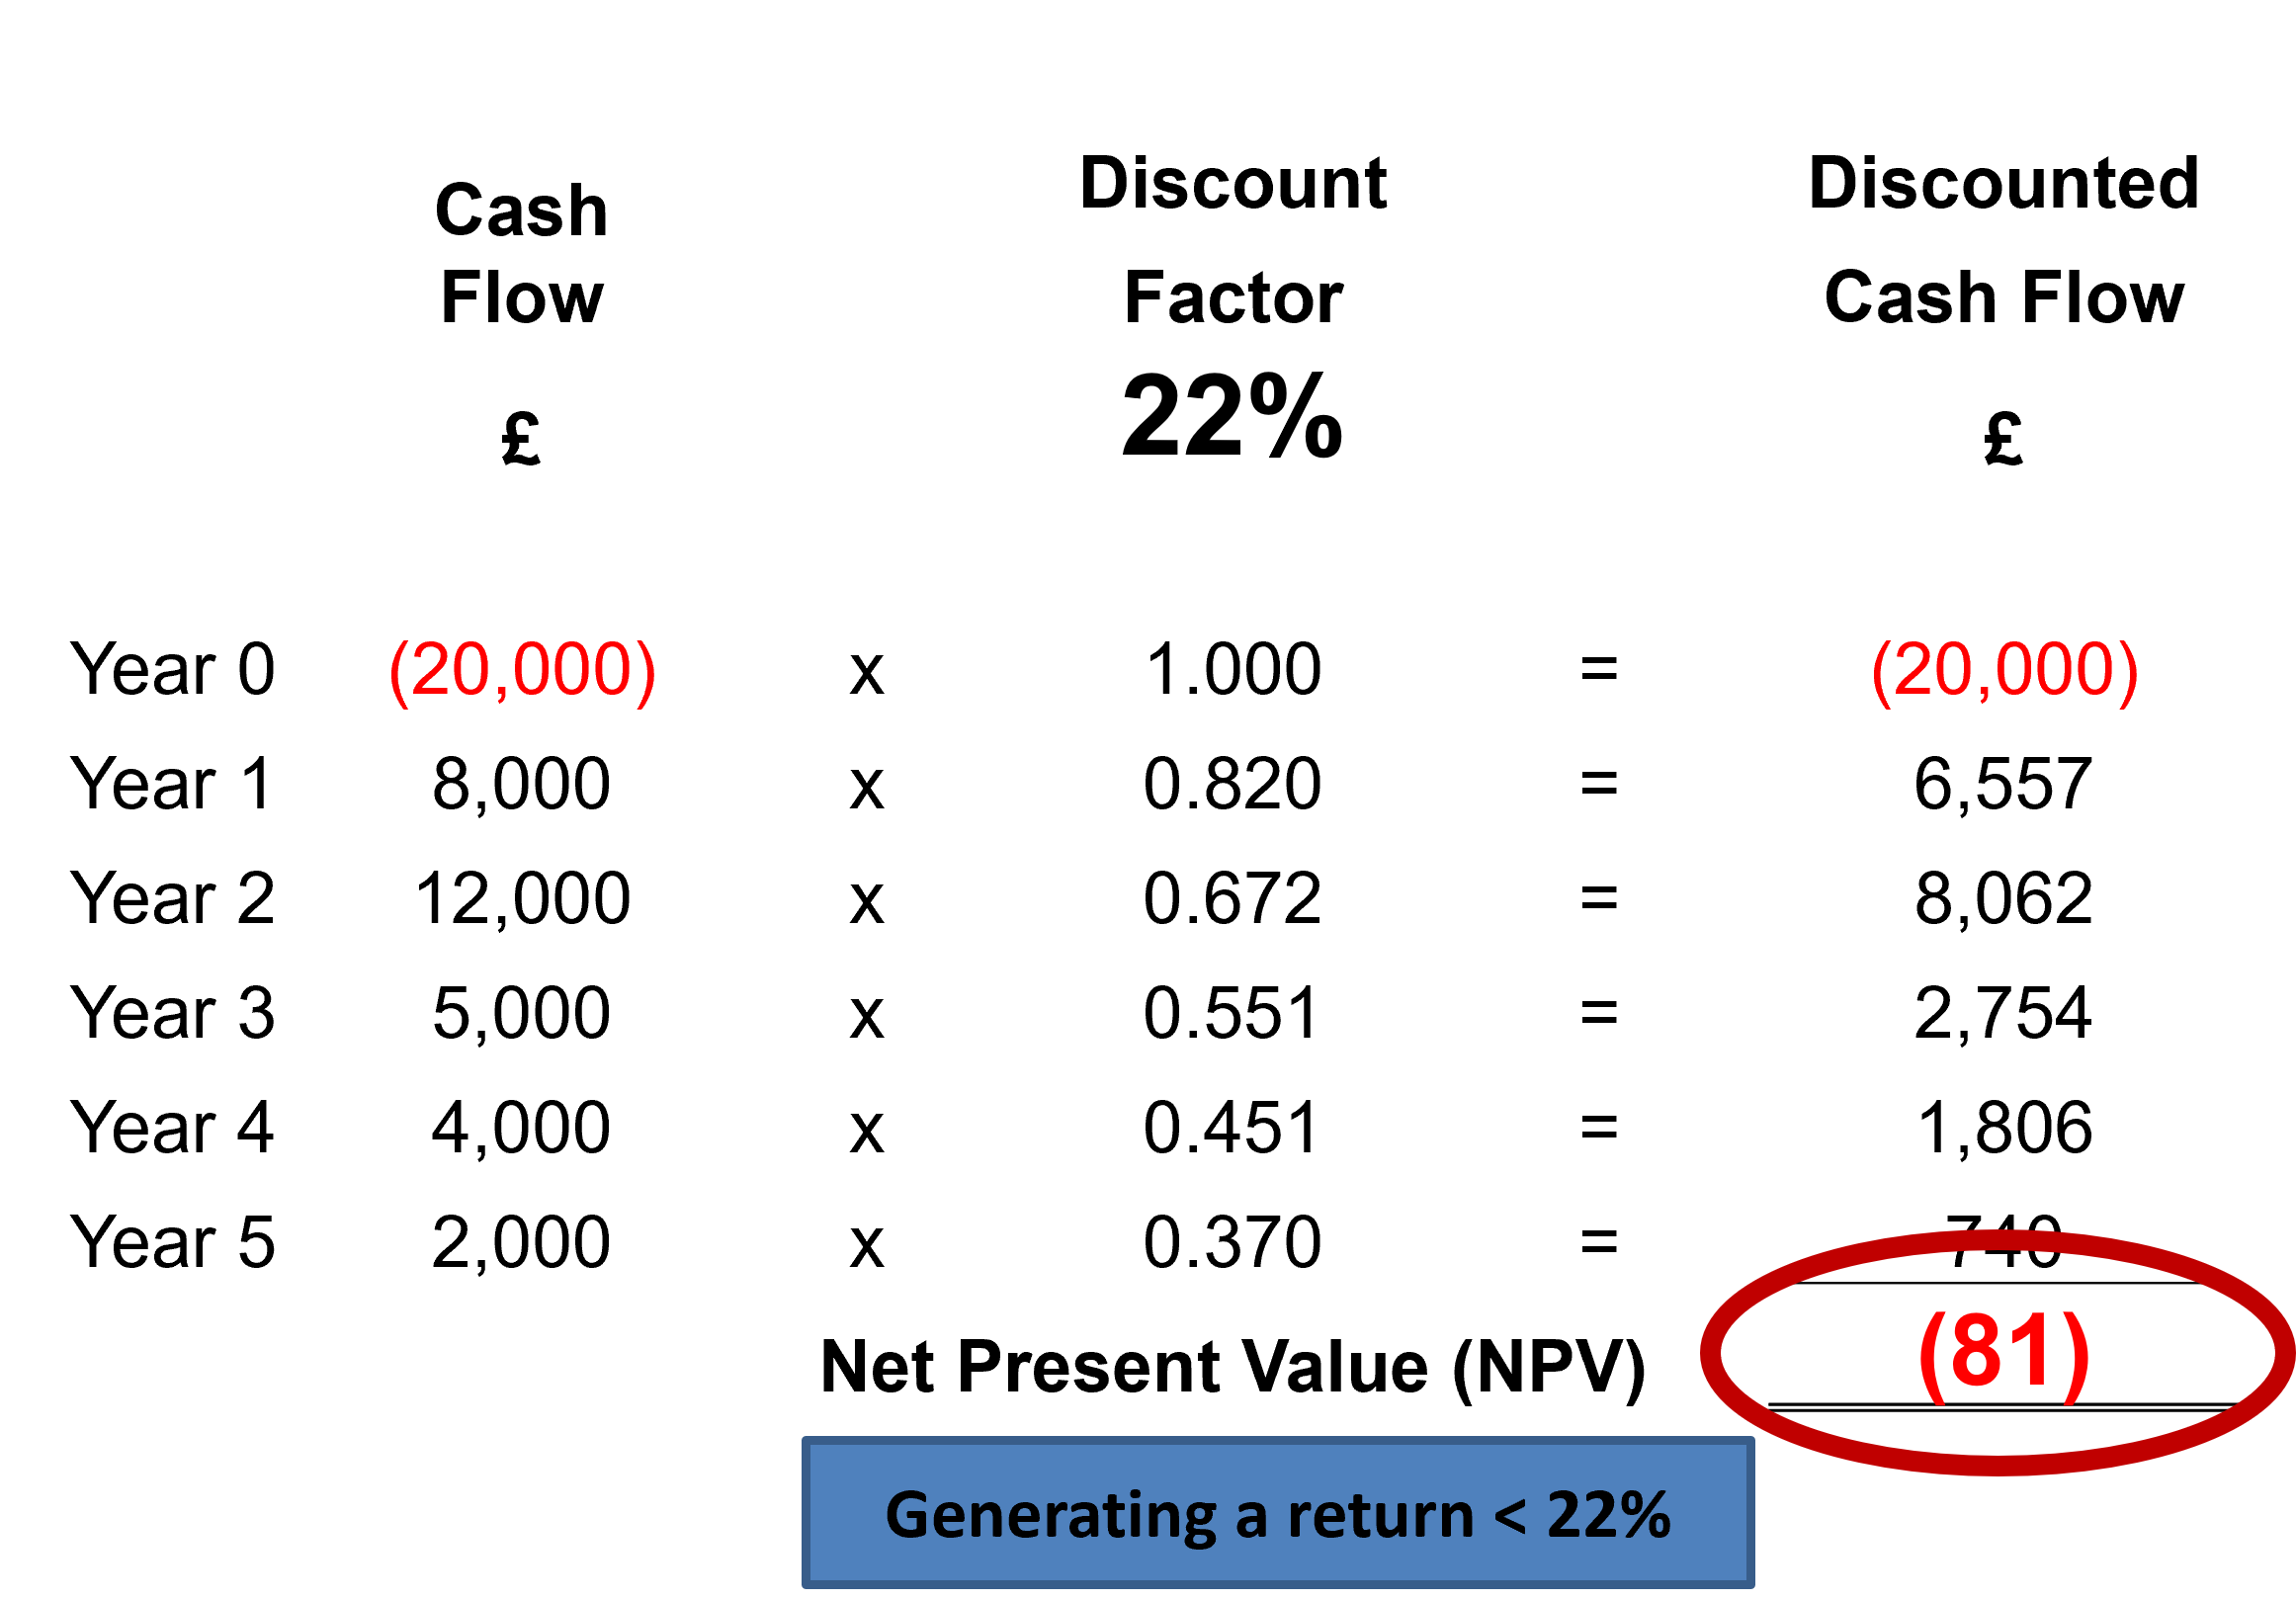
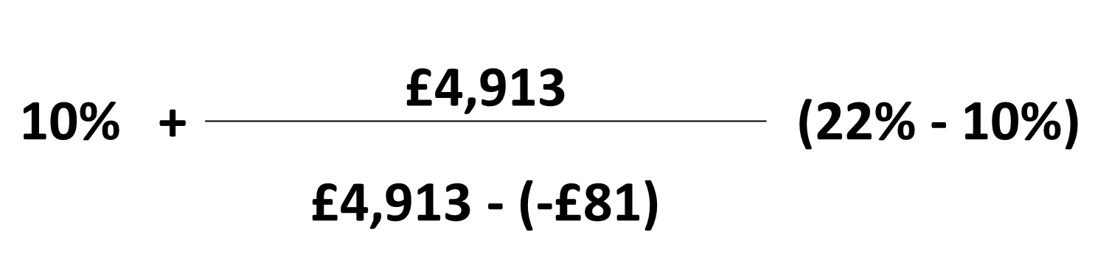
IRR - example
At 10% the NPV is £4,913 so in order to reduce the NPV
we must increase the discount rate
If we discount the project flows at 22% we get an NPV of
(£81)
IRR =
where NPV₁ is the NPV at an interest rate i₁ etc.
IRR = 21.8%

Slide 18
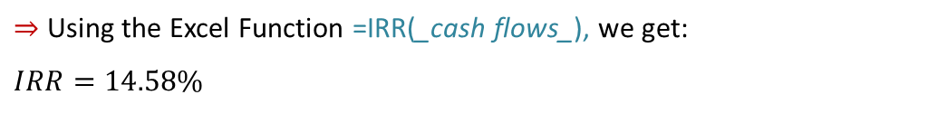
IRR in Excel
Excel – much easier
We start by a creating a table in Excel including all cash flows.
Year | 0 | 1 | 2 | 3 | 4
Design 1 ($/year) | -100,000 | 25,000 | 29,000 | 32,000 | 60,000
$⇒$ Using the Excel Function =IRR(_cash flows_), we get:
$$IRR=14.58\%$$

Slide 19
IRR – Benefits and Drawbacks
The benefits of IRR:
all cash flows used.
timing of cash flows taken into account.
calculations easy to make with tables.
directly shows change to shareholders’ wealth as a result of the decision.
allows variable discount rates to account for different economic circumstances.
can be aggregated across all projects.
However, it:
is stated in absolute value and does not provide a percentage return on the initial investment.
does not control for the life of the project and is biased towards projects with longer lives.
is based on forecasted cash flows which could lead to errors.
required rate of return difficult to ascertain.
not easily understood by non-finance staff.
Notes:
Here’s a clear breakdown of the benefits and drawbacks of IRR (Internal Rate of Return) as an investment appraisal technique:
Benefits
Time value of money considered – IRR accounts for the fact that money today is worth more than money in the future.
Easy to interpret – The result is a single percentage rate, making it simple to compare with required rates of return or cost of capital.
Relative measure – Useful for comparing projects of different sizes without needing absolute monetary values.
Clear decision rule – Accept projects where IRR exceeds the hurdle rate, reject if it falls below.
Considers all cash flows – Takes into account the entire life of the project, not just part of it.
Drawbacks
Multiple IRRs possible – Projects with unconventional cash flows (cash outflows occurring after inflows) can produce more than one IRR, creating confusion.
Assumes reinvestment at IRR – The method assumes interim cash flows are reinvested at the project’s IRR, which may be unrealistic.
Not always suitable for mutually exclusive projects – IRR can give misleading results when comparing projects of different scales, timings, or lifespans.
Ignores absolute value – A high IRR might come from a small project with minimal actual monetary gain.
More complex to calculate – Unlike ARR or Payback Period, IRR requires iterative or computational methods.
If you’d like, I can also give you a quick exam-friendly comparison of IRR vs NPV so you can see where each is stronger. That often comes up alongside this question.

Slide 20
Other factors to be considered
source of finance
cost of capital
total estimated cost of project
taxation implications
working capital requirements
audit of project
economic climate, political implications, length of commissioning, training, location, capacity

Slide 21
Learning Outcomes Covered
Consider why the time value of cash flows is important within an investment decision.
Apply the NPV and IRR calculations to a given scenario
Review the advantages and disadvantages of both methods.
Consider the Net Present Value (NPV) and Internal Rate of Return (IRR) method and how they are calculated

Slide 22
Next Week
Sources of Finance

